Slide 1

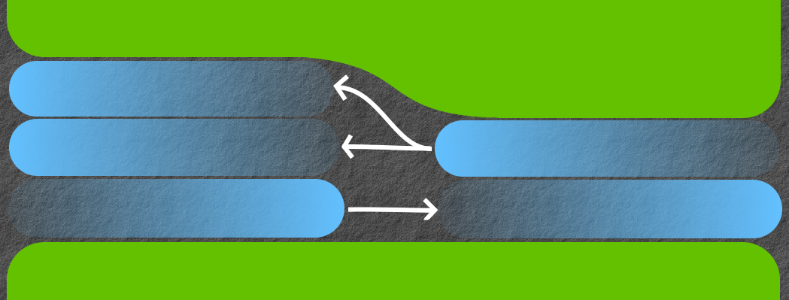
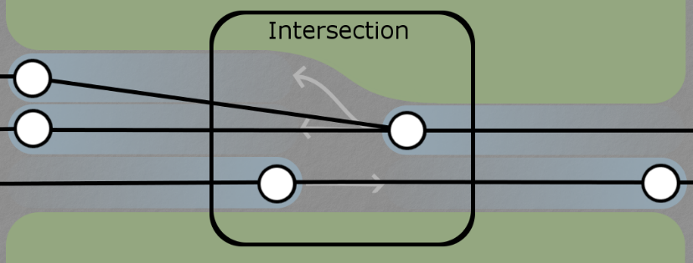
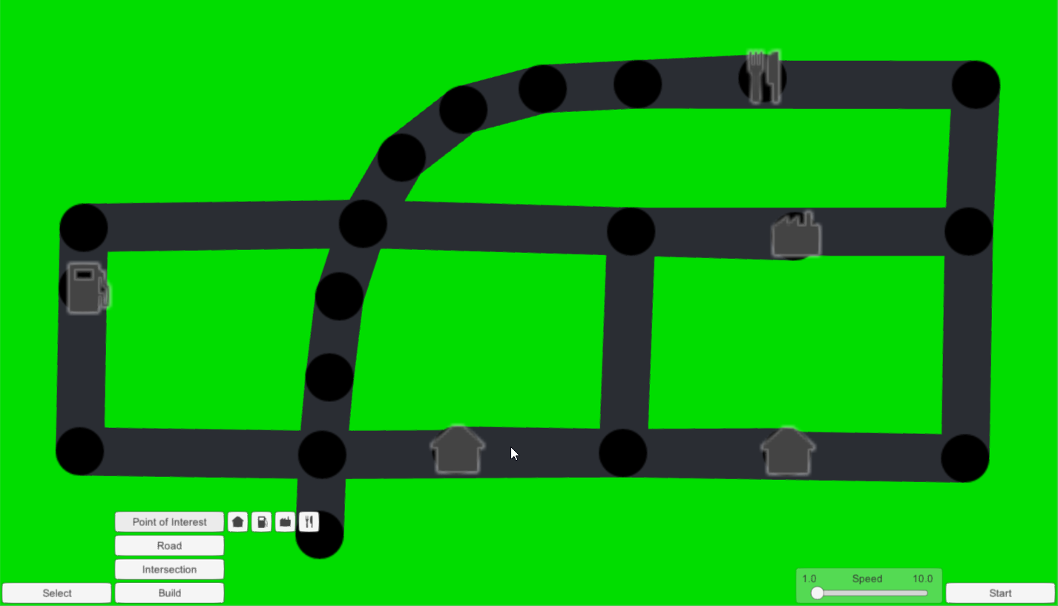
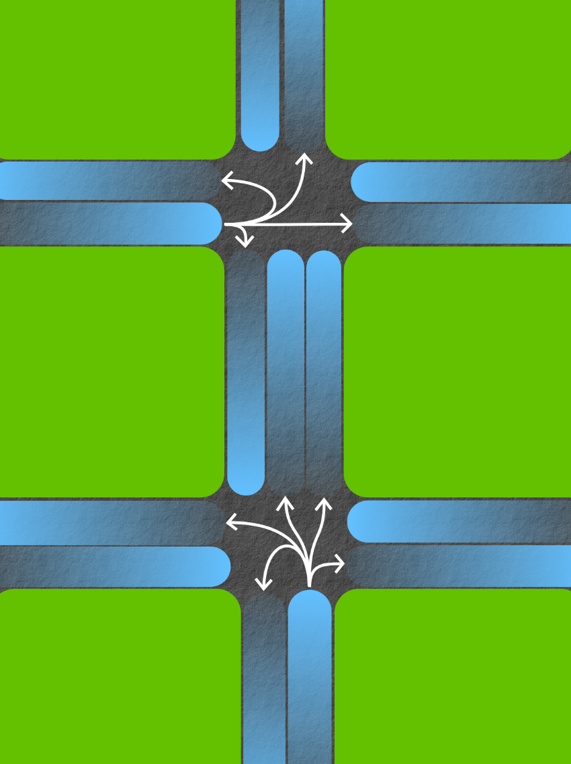
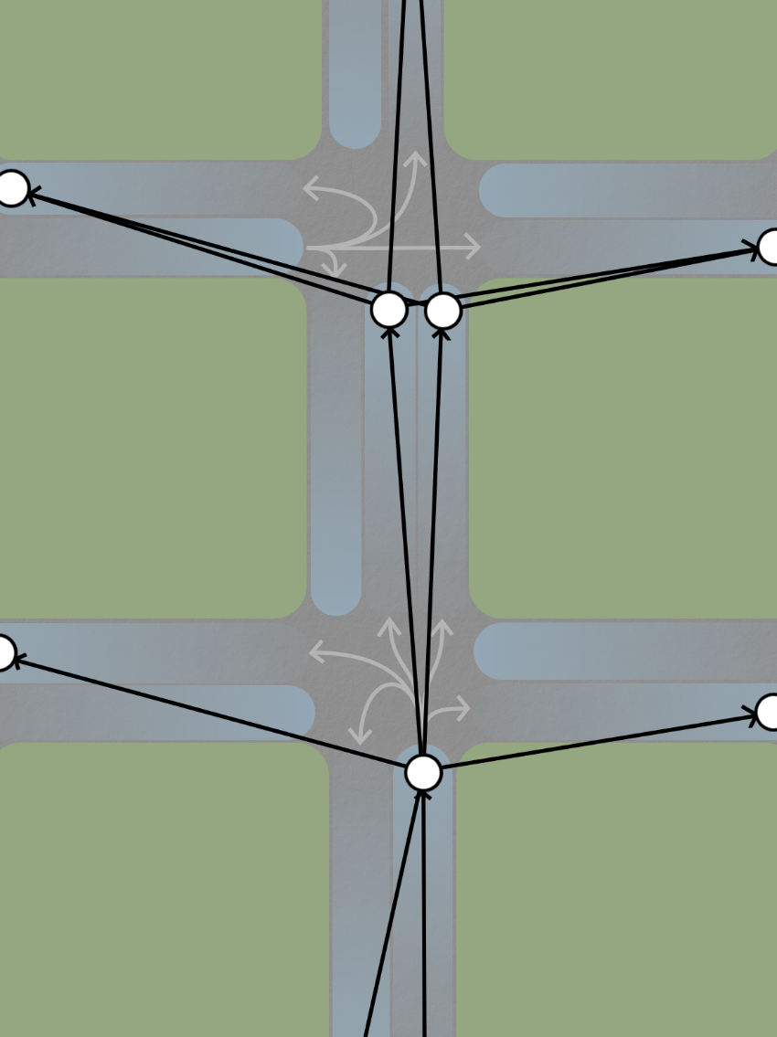
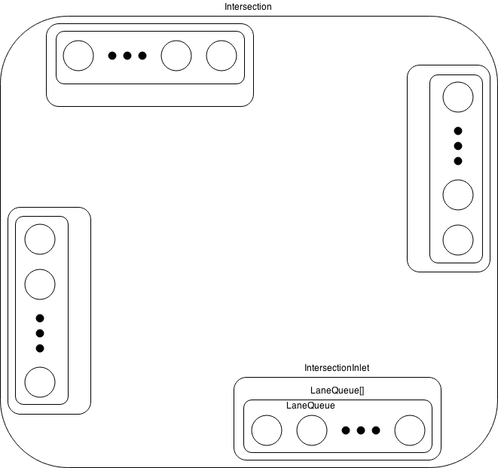
Object Oriented Traffic Simulation
By Nick Powers, and Jordan White
CS 4491 - Dr. Jose Garrido
Vehicle Navigation
A routing algorithm was developed to help vehicles navigate the road network to their destination. Storing the road network as a directed graph allows us to use the Bellman Ford algorithm to compute the minimum cost between every two nodes. Using that information a next-hop matrix is constructed where each element represents the adjacent node to travel to from any given node.
Images
Intersections
Introduction
The following outlines the development of a process-based traffic simulation. Development consisted of devising a routing algorithm, and designing concurrent software.
Routing Algorithm
.
The Interface so far
.
Intersection

